Slide 1
Farm-Markets API
Presenting by: Manish Sai Jakkula - ZPMJ-10114

Slide 2
Introduction
The Farm Markets API is a digital marketplace.
Built with Fast API and MongoDB.
Farmers can list products.
Buyers can purchase directly from farmers.
Uses JWT authentication for secure access.

Slide 3
Technology Stack
Fast API – High-performance web framework
MongoDB + Motor – Async database for users/products/orders
JWT – Authentication and session management
Passlib (bcrypt) – Password encryption
dotenv – Manage environment variables (like secret keys)

Slide 4
Security & Authentication
JWT tokens issued at login
Tokens blacklisted on logout
Role-based access control: Farmers manage products, Buyers place orders
Passwords encrypted using bcrypt

Slide 5
Key Endpoints
Users: Register, Login, Get Profile
Farmers: Create/Update farmer profile
Buyers: Create/Update buyer profile
Products: Add, Update, Delete (farmers only)
Orders: Place orders, Get orders (buyers only)
Logout: Blacklist the token

Slide 6
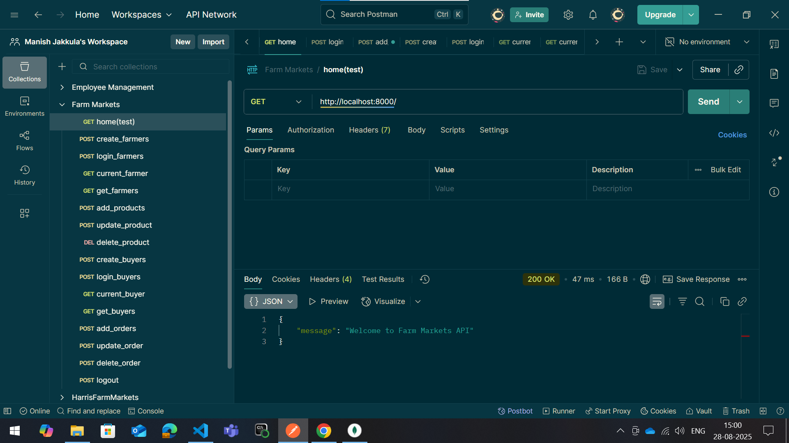
1. Home page

Slide 7
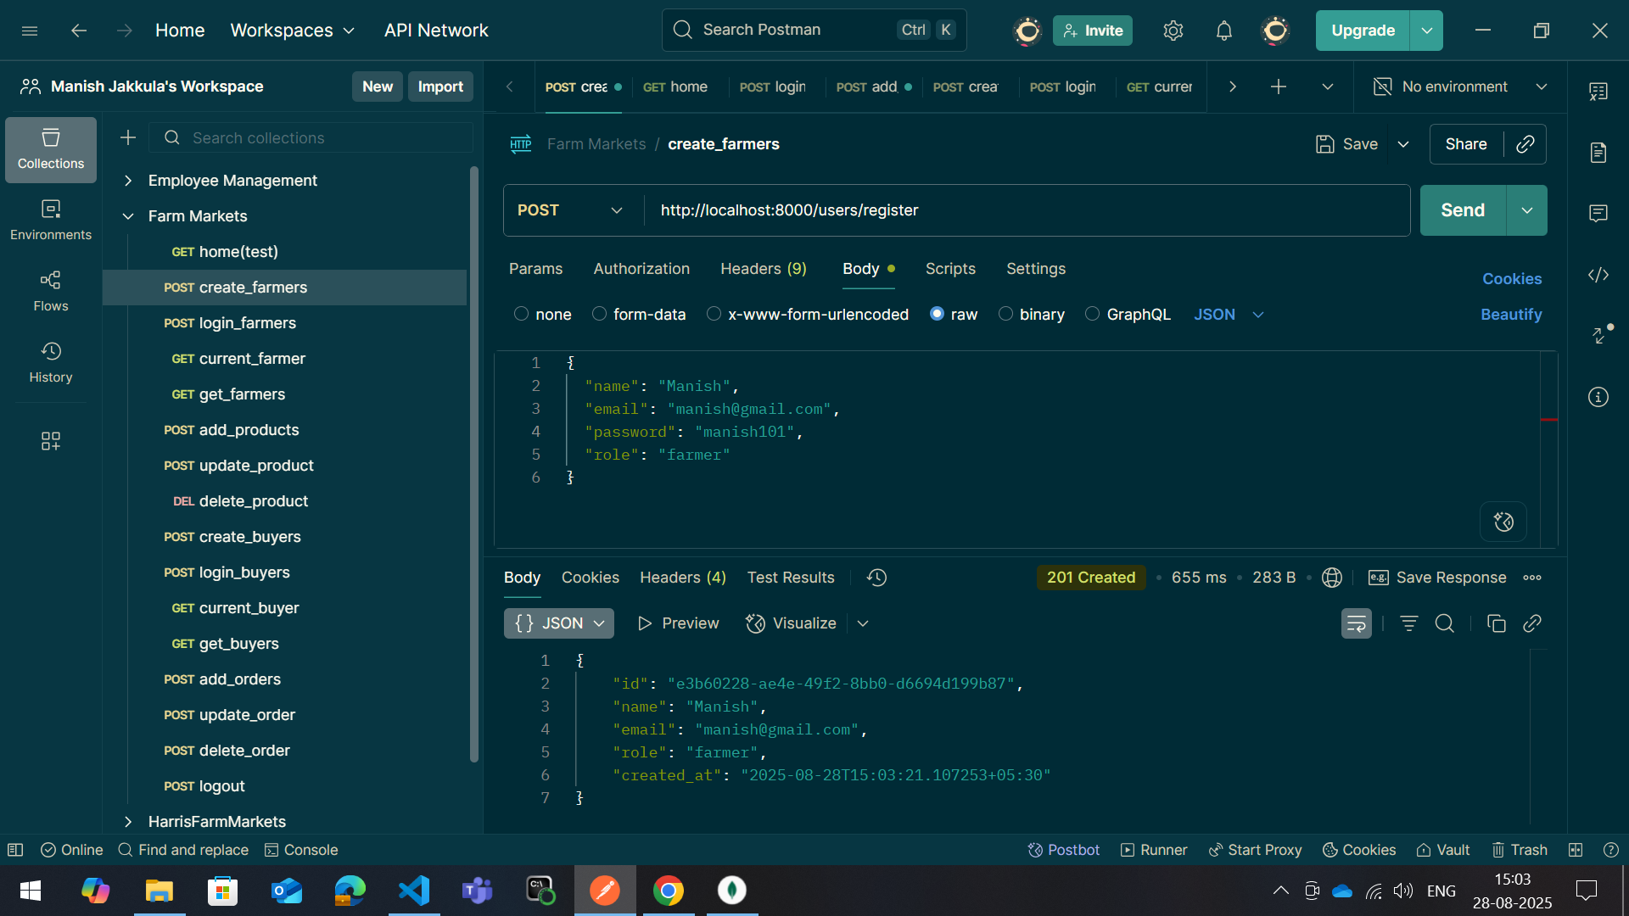
2. Create-farmer

Slide 8
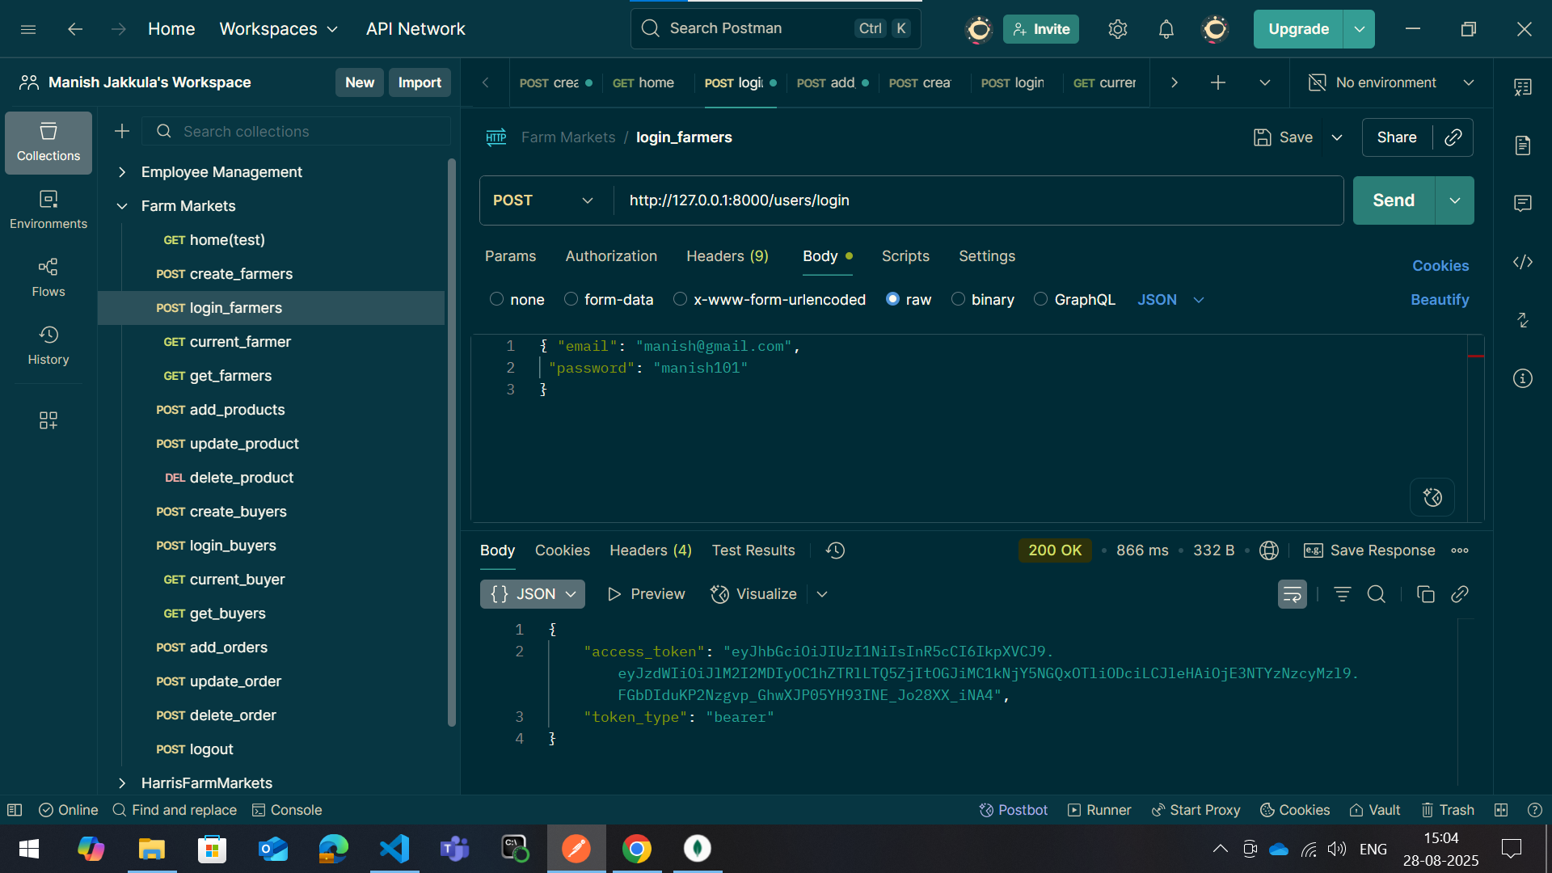
3. Login-farmer

Slide 9
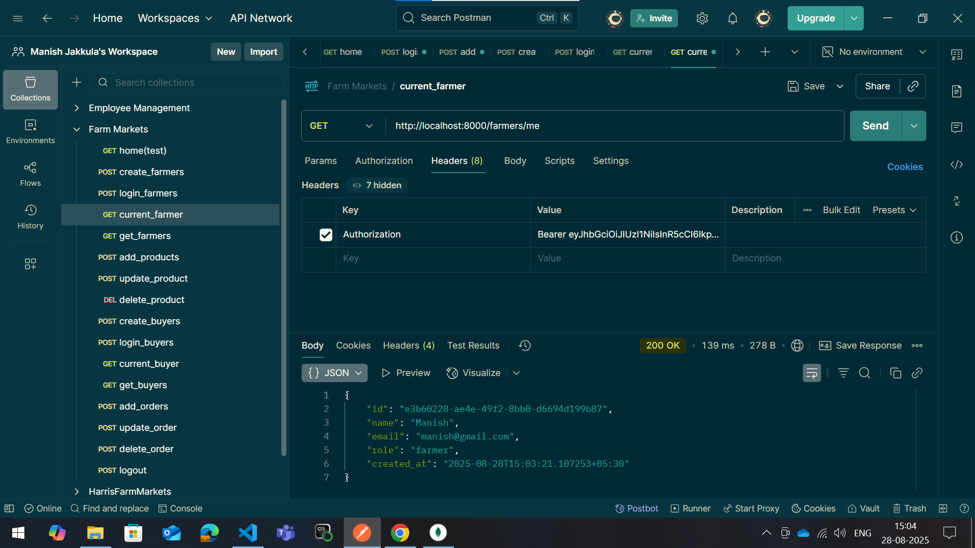
4. Current-farmer

Slide 10
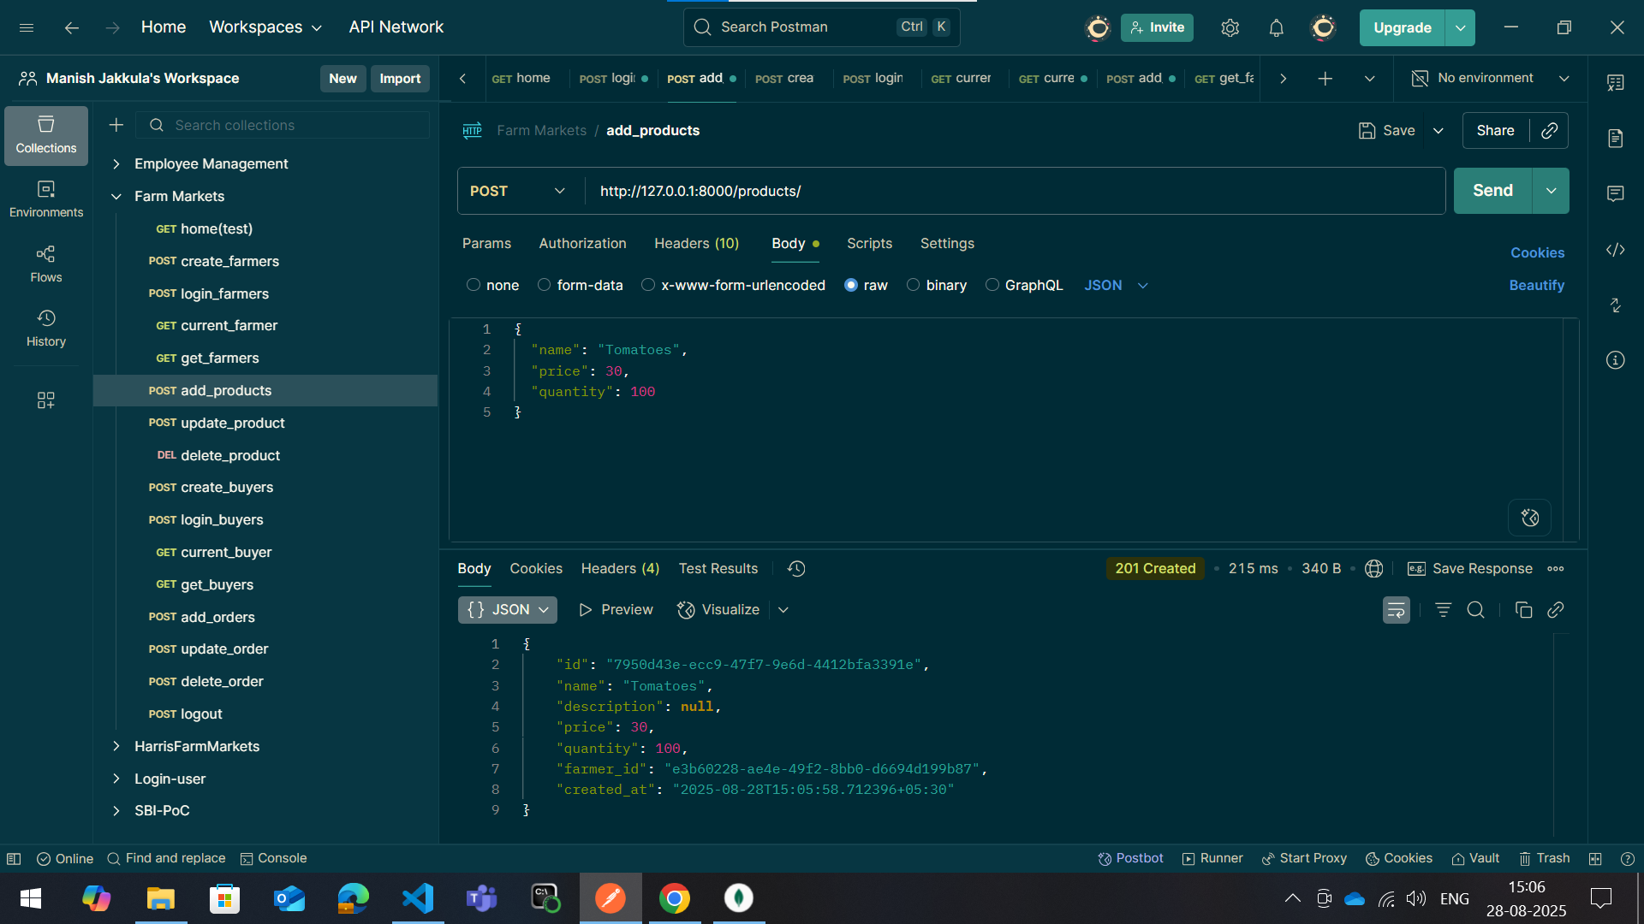
5. Add-product

Slide 11
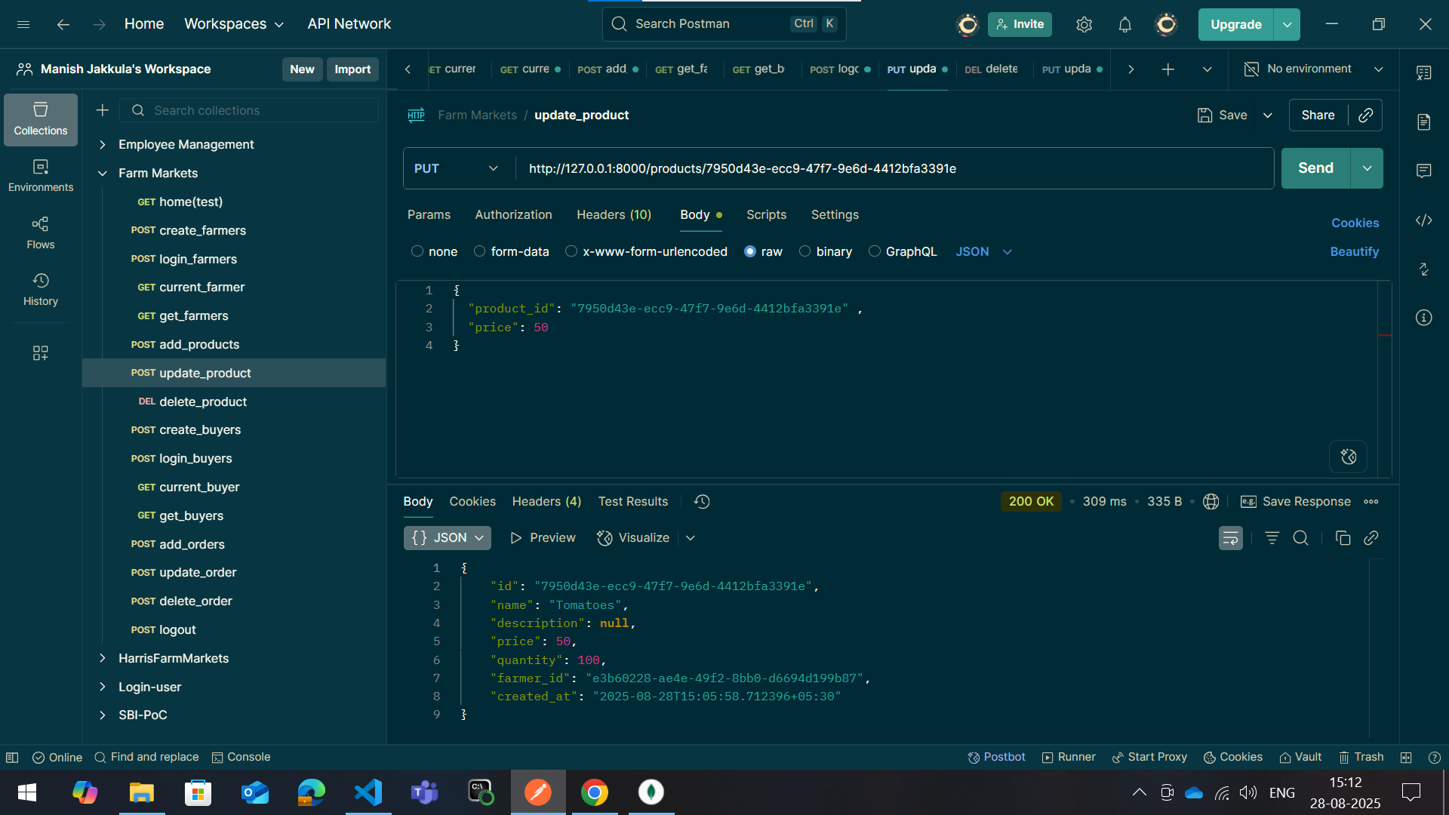
6. Update-product

Slide 12
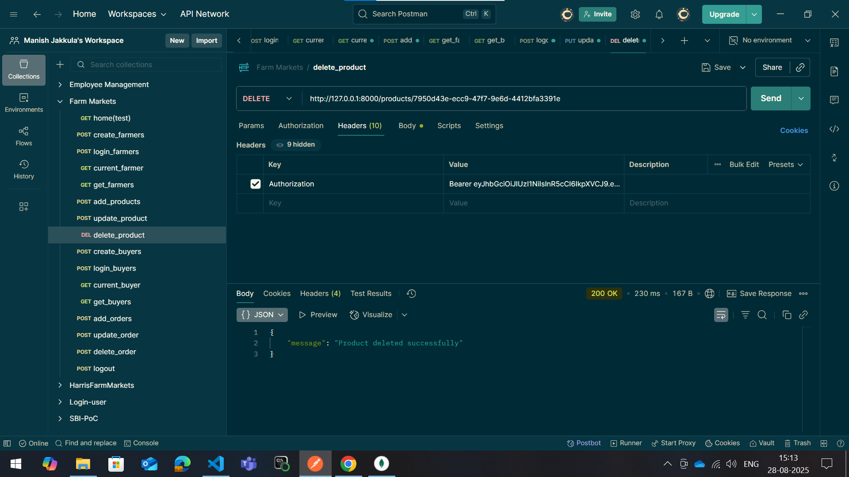
7. Delete-product

Slide 13
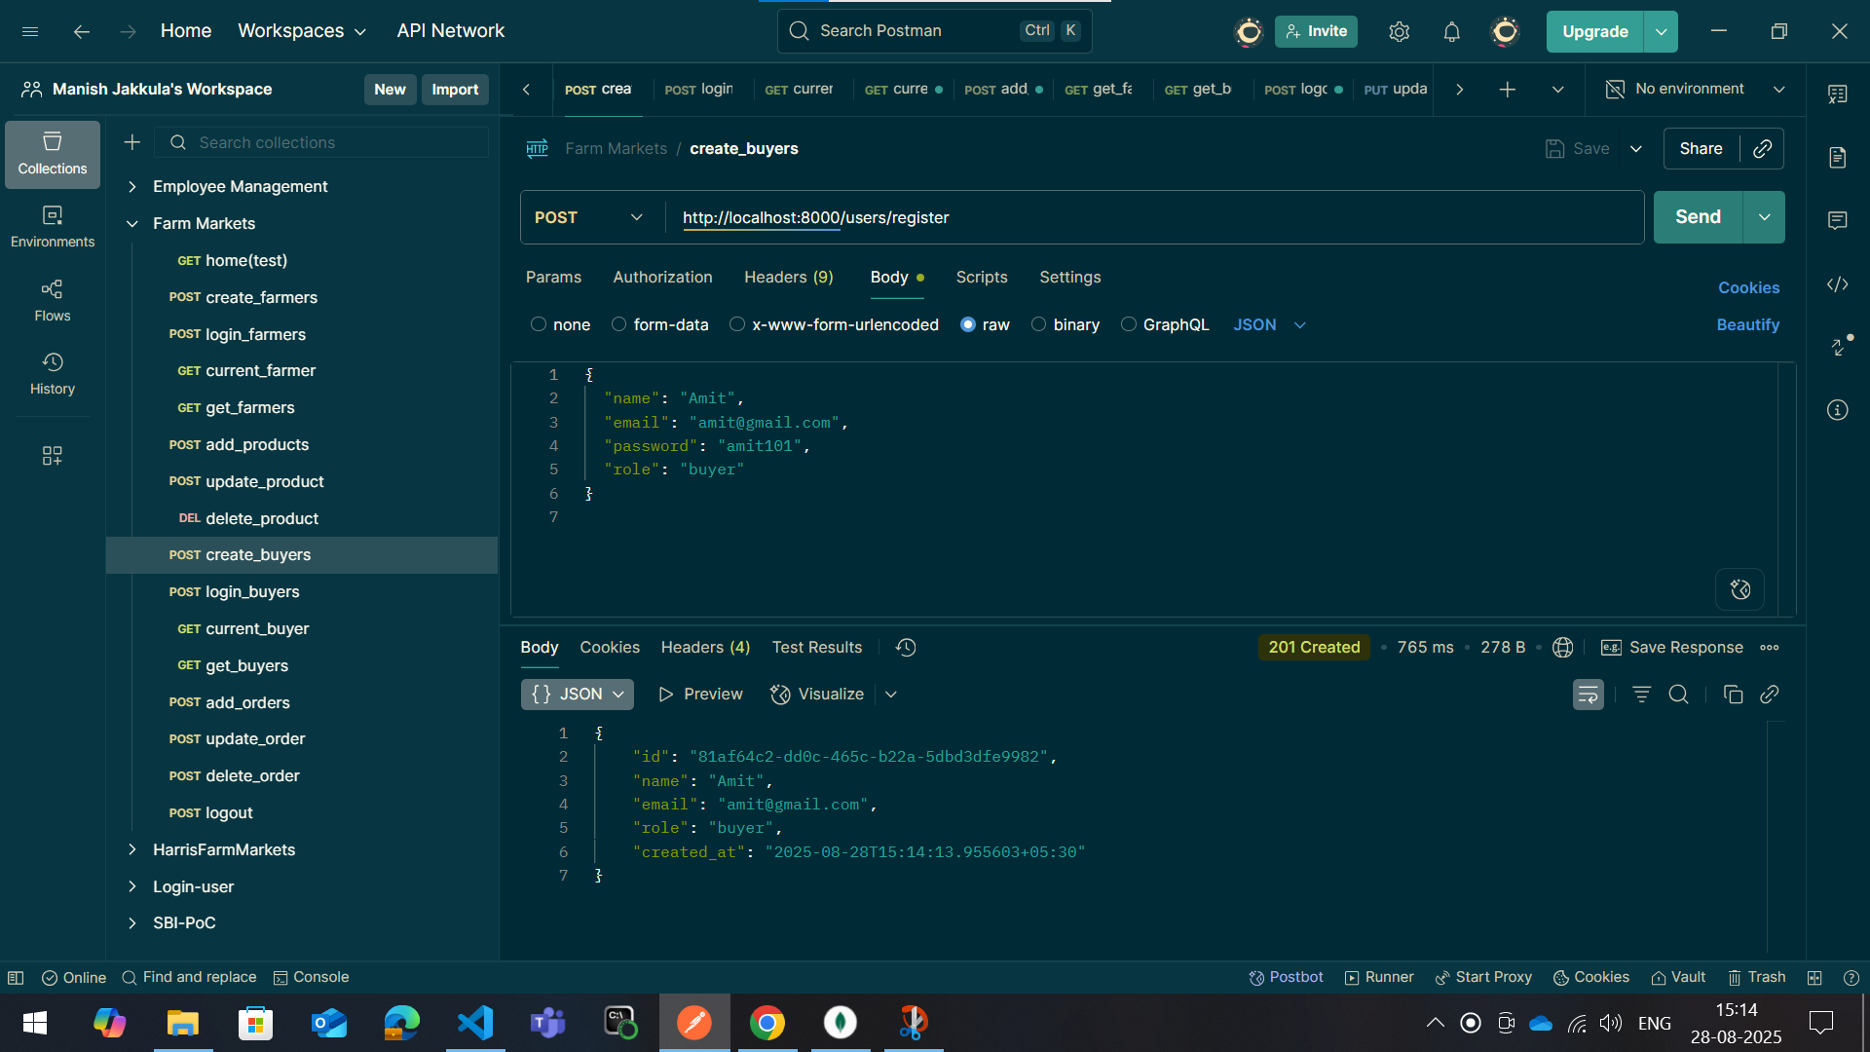
8. Create-buyer

Slide 14
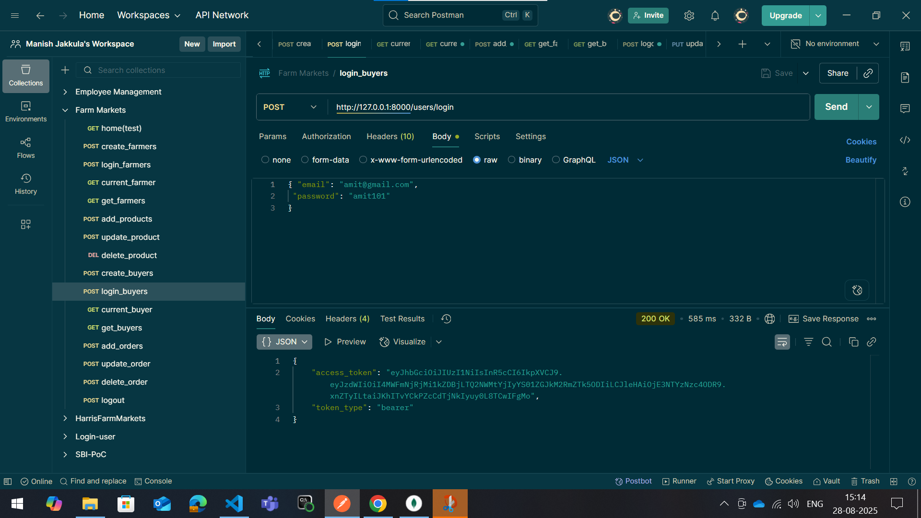
9. Login-buyer

Slide 15
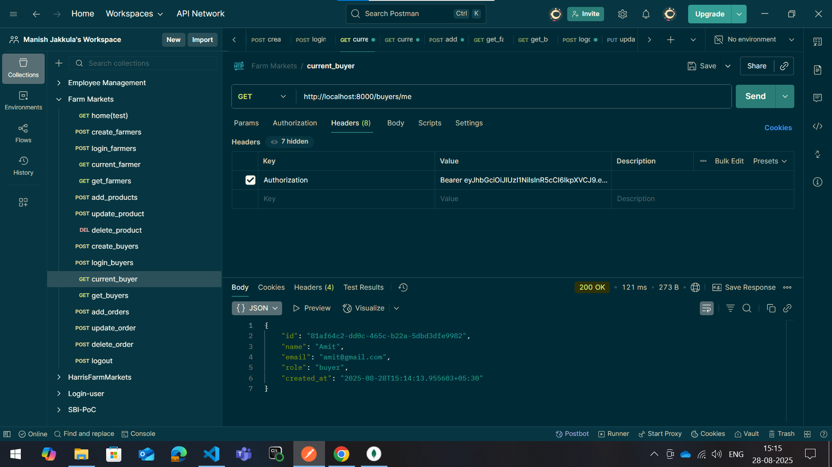
10. Current-buyer

Slide 16
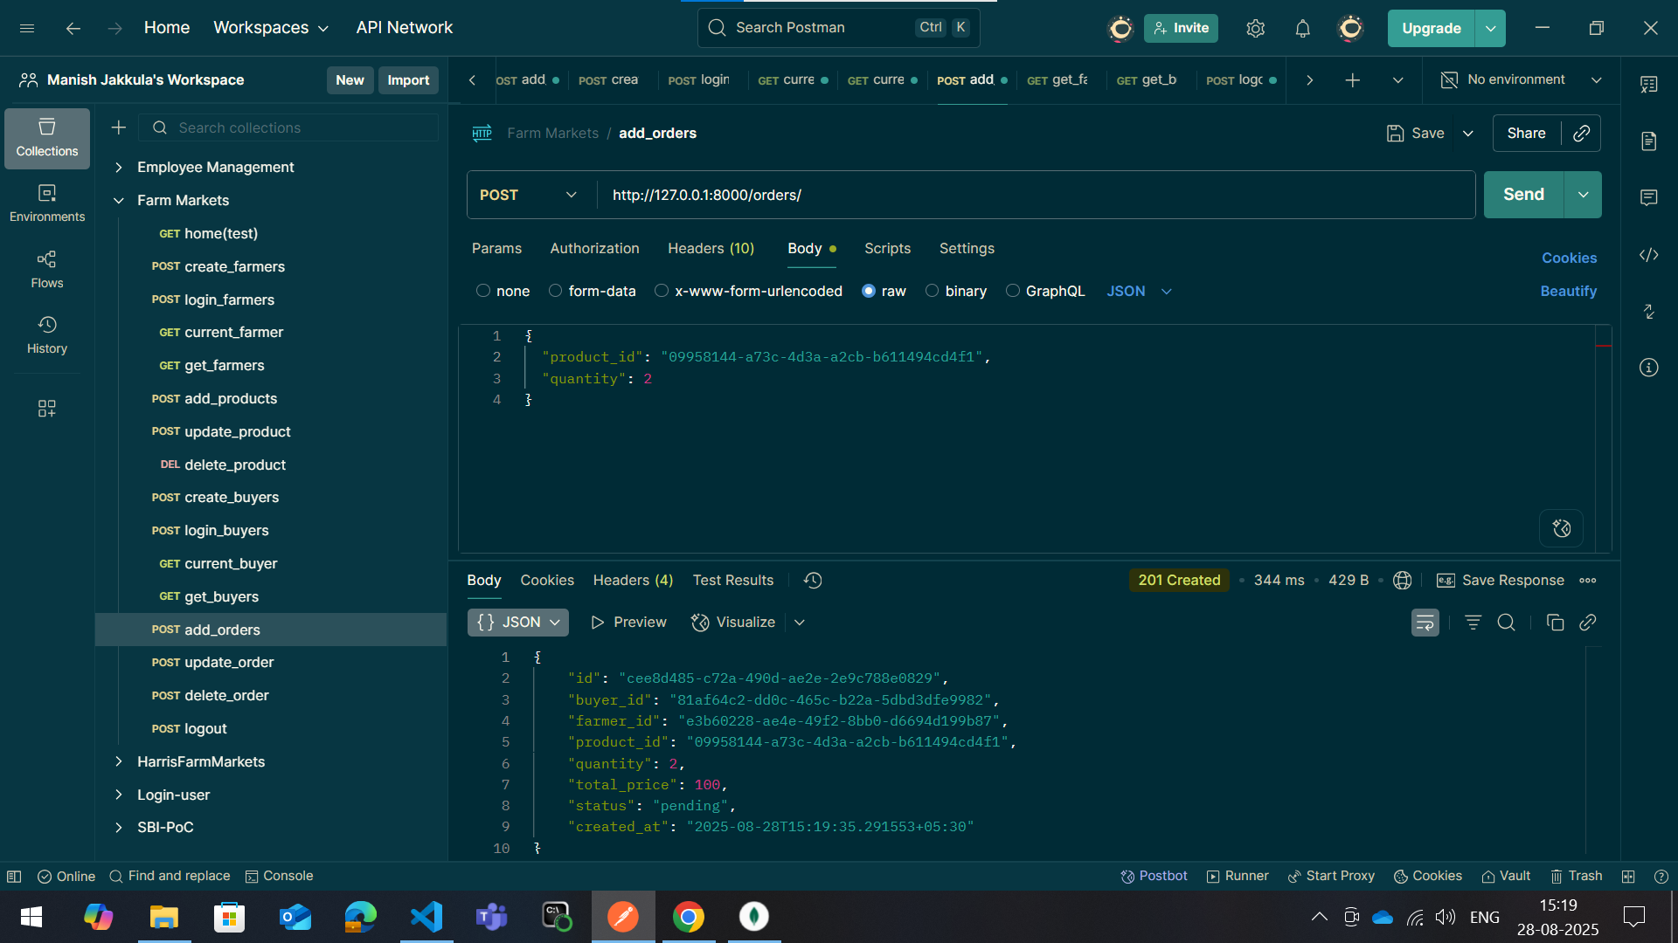
11. Add-order

Slide 17
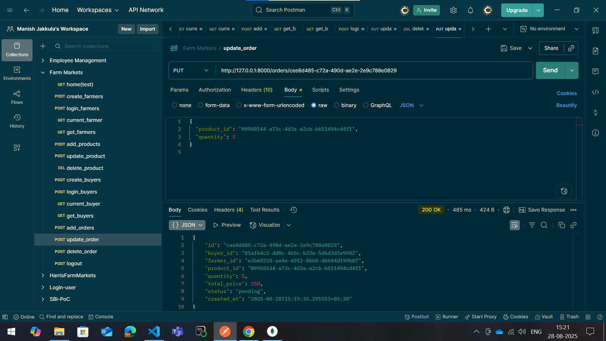
12. Update-order

Slide 18
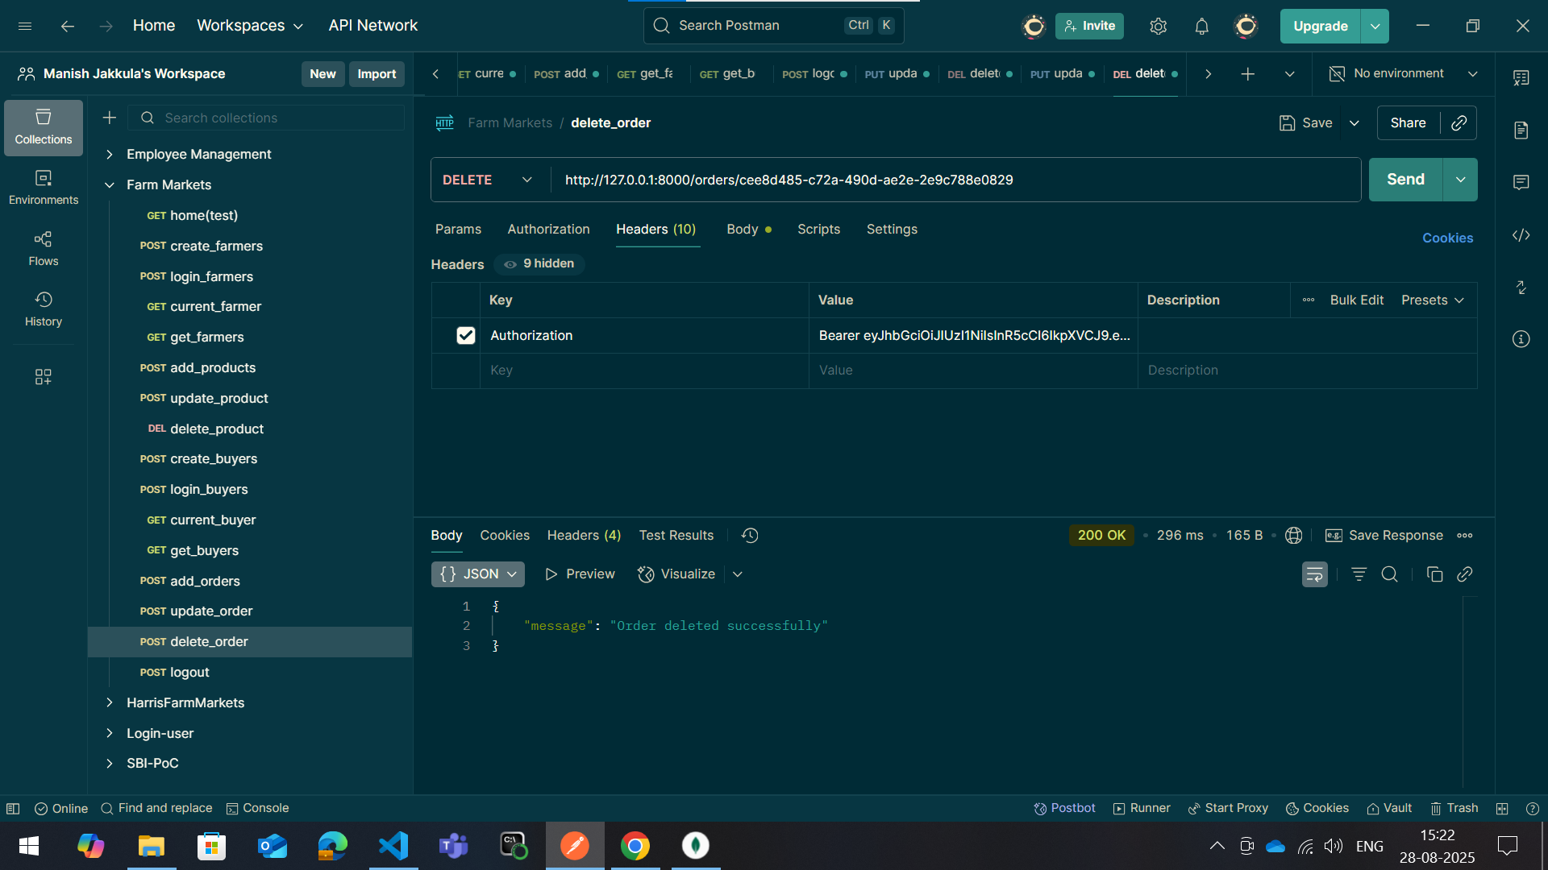
13. Delete-order

Slide 19
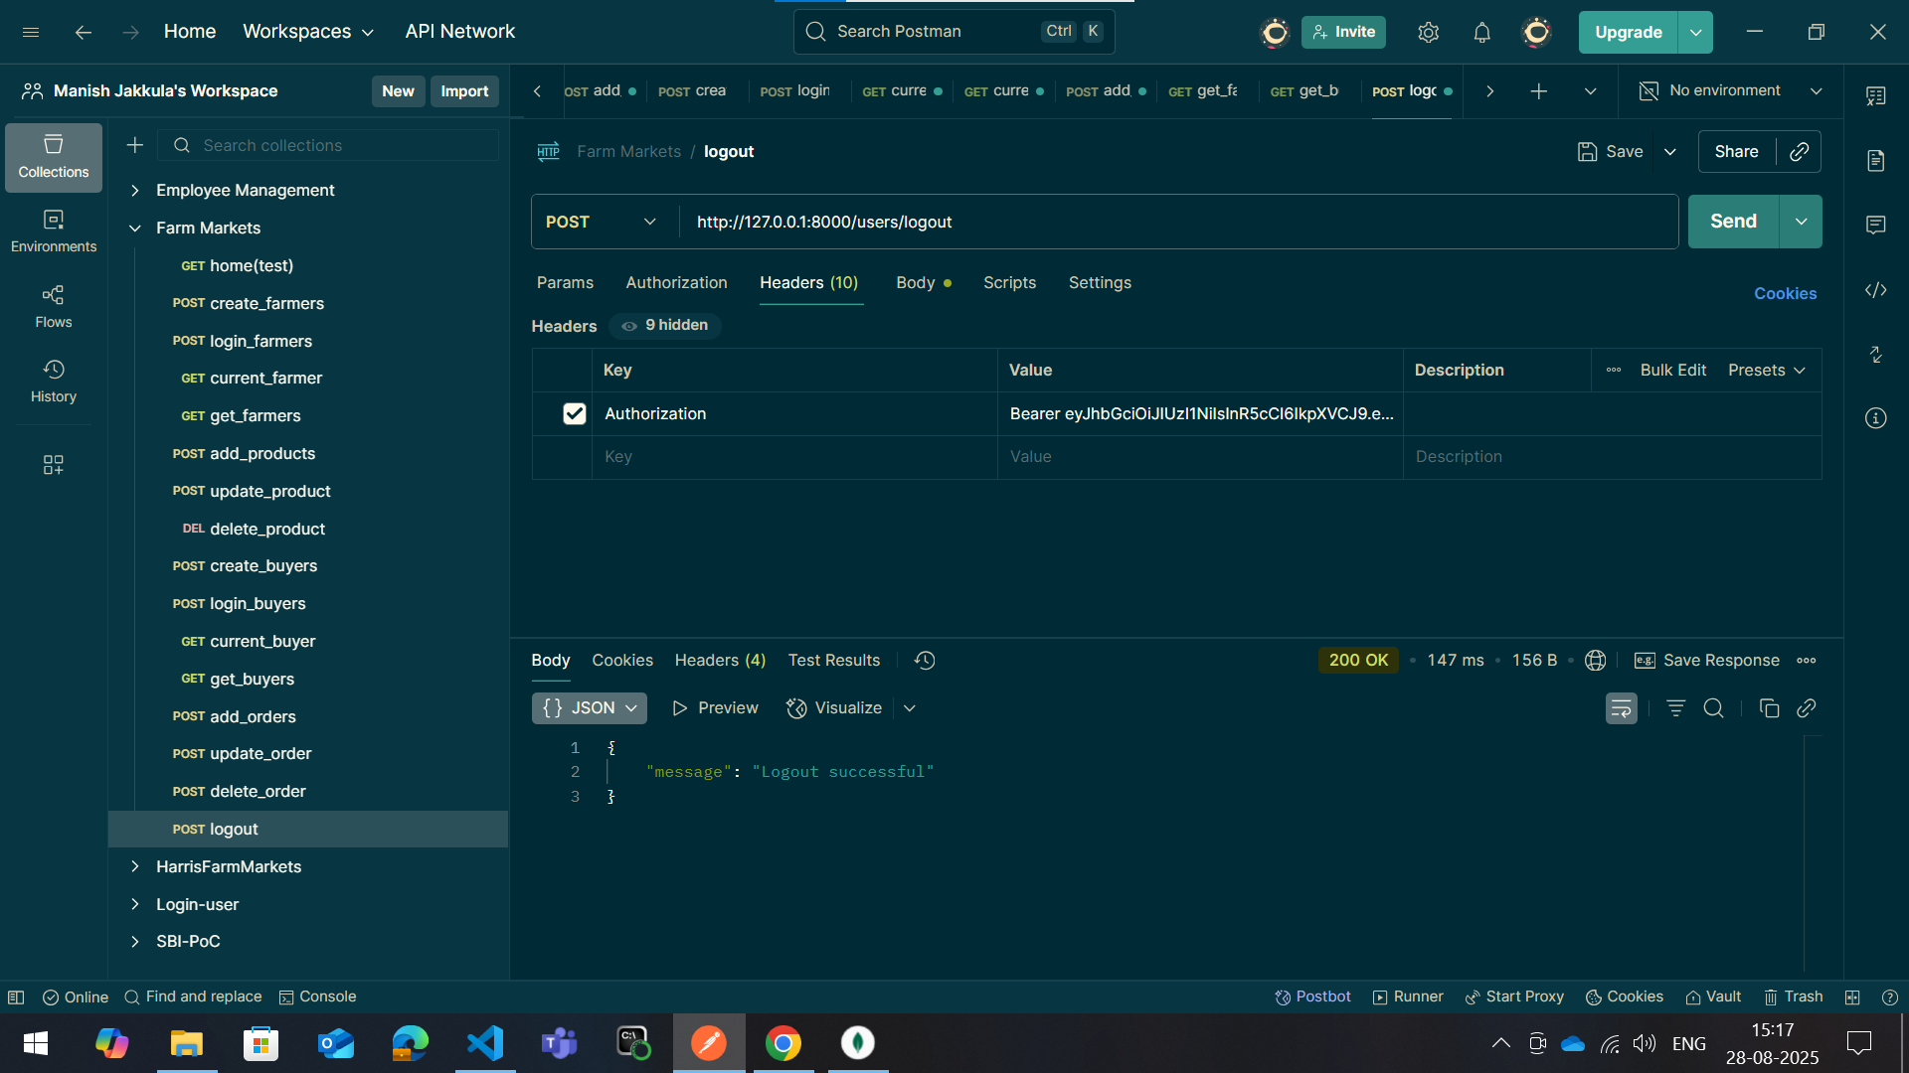
14. Logout-user

Slide 20
Usage Flow
1. User registers and logs in → gets a JWT
2. Farmer lists products
3. Buyer browses available products
4. Buyer places an order
5. Orders can be tracked
6. Logout → token blacklisted

Slide 21
Benefits
For Farmers:
- No middlemen → more profit
- Easy product listing
- Builds trust with buyers
For Buyers:
- Fresh produce directly from farmers
- Transparent prices
- Wide product choices
- Secure transactions

Slide 22
Conclusion
API creates a bridge between farmers and buyers
Ensures trust, transparency, and profitability
Helps farmers reach wider markets
Gives buyers fresh and affordable produce
Secure, scalable, and user-friendly solution

